Slide 1

VISVESVARAYA TECHNOLOGICAL UNIVAERSITY “JNANASANGAMA”,BELAGAVI-590018
K R PETE KRISHNA GOVERNMENT ENGINEERING COLLEGE,KR PET-571426
2023-2024
Department of Computer Science & Engineering
Project Phase-1 Presentation On
“Enhanced Technique to Assist Visually Impaired and Blind People”
Presenting By
B V DISHA 4GK20CS004
SOWMYA B 4GK20CS031
THIPPEGOWDA B M 4GK20CS039
KAVANA S P 4GK21CS406
Under the Guidance of Head of the Department
Dr. Nagappa U Bhajantri Dr. Hareesh K
Professor Associate Professor &HOD
Dept of CS&E Dept of CS&E

Slide 2

Contents
Introduction
Literature Survey
Motivation and Challenges
Existing System and Drawbacks
Proposed System
Problem Statement
Objectives
Applications Of The Project
System Architecture with its module
System Requirements
Remarkable Observations
References

Slide 3
Introduction1
The “Enhanced Techniques to assist Visually Impaired and Blind People” empowers visually impaired individuals to navigate their surroundings with greater autonomy and safety.
Represents significant leap in assistive technology, promising greater independence and safety.
Relies on the integration of Machine Learning and Image Processing techniques.
DEPT OF CS&E

Slide 4
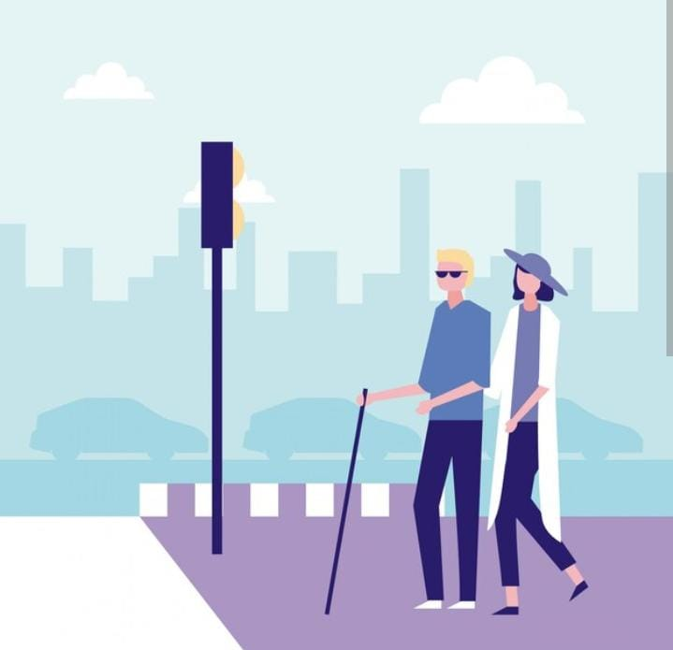
Introduction2
Blind people find hard time navigating around the street.
For visually impaired people to be able to provide, experience their vision, imagination mobility is necessary.
With the advancement in technologies, diverse solutions have been introduced.
However, these solutions have disadvantages.
So, we propose a system built on the break through of image processing and machine learning.
DEPT OF CS&E

Slide 5
Literature Survey
SL.NO | TITLE OF THE PAPER | AUTHORS | YEAR OF PUBLICATION | PROPOSED SYSTEM | OUTCOME
1. | “Reader and Object Detector for Blind” | 1.M Murali. 2.Shreya sharma. 3.Neel nagansuri. | 2020 | Text reading - OCR and TTS Synthesis. Object Detection-TensorFlow Object Detection API. | Detect various objects in its surroundings and provide an audio feedback.
2 | “Automatic Object Detection and Recognition to assist Blind People” | 1.Ervin yohannes. 2.Paul lin. 3.Chih-yang lin*. 4.Timothy k.shih. | 2020 | Using ZED stereo camera, a camera that can calculate depth information of object and can also capture the image of an object. | Achieves an accuracy rate of about 81%, which is better than naive YOLO v3.
DEPT OF CS&E

Slide 6
Literature Survey
SL. NO | TITLE OF THE PAPER | AUTHORS | YEAR OF PUBLICATION | PROPOSED SYSTEM | OUTCOME
3 4 | “Assisting Blind People Using Object Detection with Vocal Feedback” “Smart Assistive System for Visually Impaired People Obstruction Avoidance Through Object Detection and Classification” | 1.Heba najm 2.Khirallah Elferjni 3.Alhaam alariyibi. 1.Usman Masud 2.Tareq Saeed 3.Hunida m. Malaikah 4.Fezan Ul Islam 5.Ghulam Abbas | 2022 2022 | You Look Only Once (YOLO) model is utilized which is CNN-based real-time object detection technique along with Open CV and deep learning. Viola jones and Tensorflow Object Detection algorithm . | result was evaluated by using the mean Average Precision (mAP) Maximum efficiency of 92% is achieved for detection.
DEPT OF CS&E

Slide 7
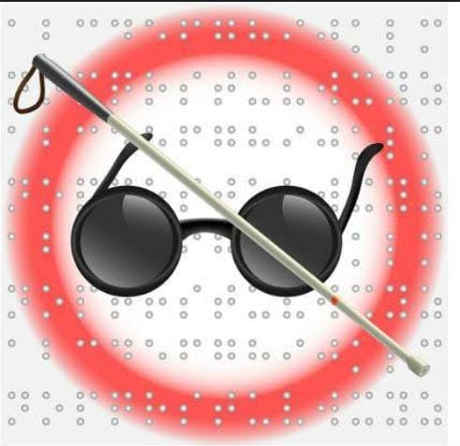
Motivation and Challenges
The project's motivation lies in fostering inclusivity, independence, and accessibility, providing a valuable tool for individuals with visual challenges to navigate and access information in their daily lives.
So far there are efforts in this direction However, those are less competitive in terms of performance and friendliness.
Mathematical model is complex and getting output accuracy is challenging factor.

Slide 8
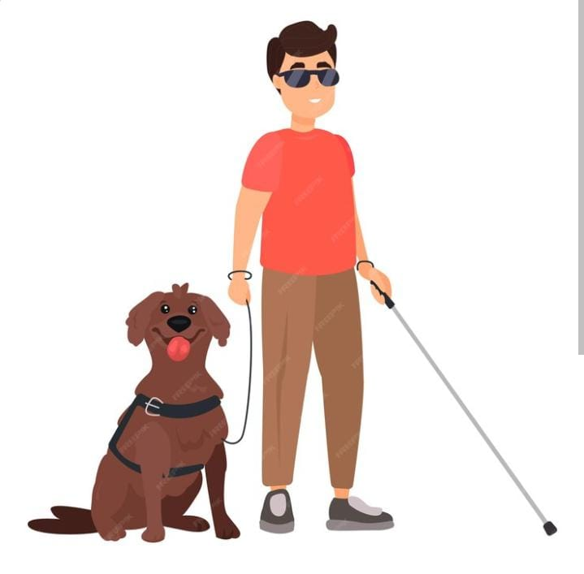
Existing System And Drawbacks
Existing System :
Trained domestic animals like dogs
cleaver rehabilitative shoes
Enlarging Devices - Handled magnifiers
Electronic glasses
Braille - To read and write
Blind Sticks
DEPT OF CS&E

Slide 9
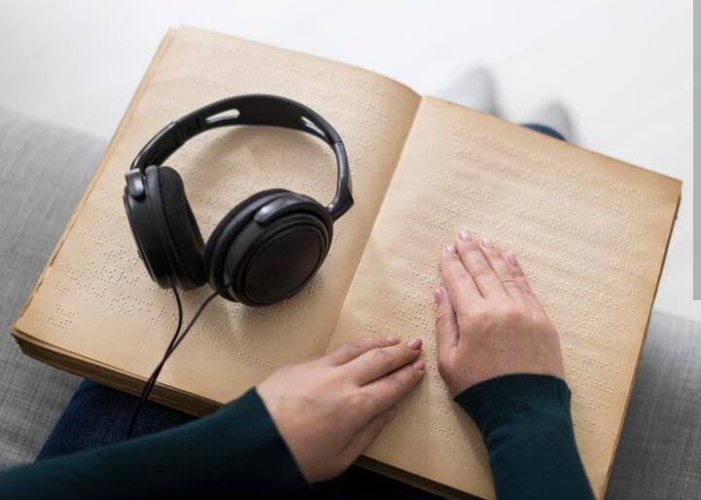
Drawbacks :
These existing devices like blind sticks can only detect obstacles after contact with object.
People cannot always relay on domastic animals.
These cannot differentiate between different kind of obstacles.
DEPT OF CS&E

Slide 10
Proposed System
Our solution to the problem is to create a device which can recognise obstacle using camera.
This system will continuously record video of the surrounding and will convert it into frames.
After analysing these frames the system will alert the person about some obstacle or the surrounding.
DEPT OF CS&E

Slide 11

Problem statement
The current obstacle detection relies on physical contact with a stick, which can be unsafe for detecting obstacles at a distance. Blind individuals face challenges reading standard books as they require specially designed accessible formats, but not all books cater to their needs.
DEPT OF CS&E

Slide 12
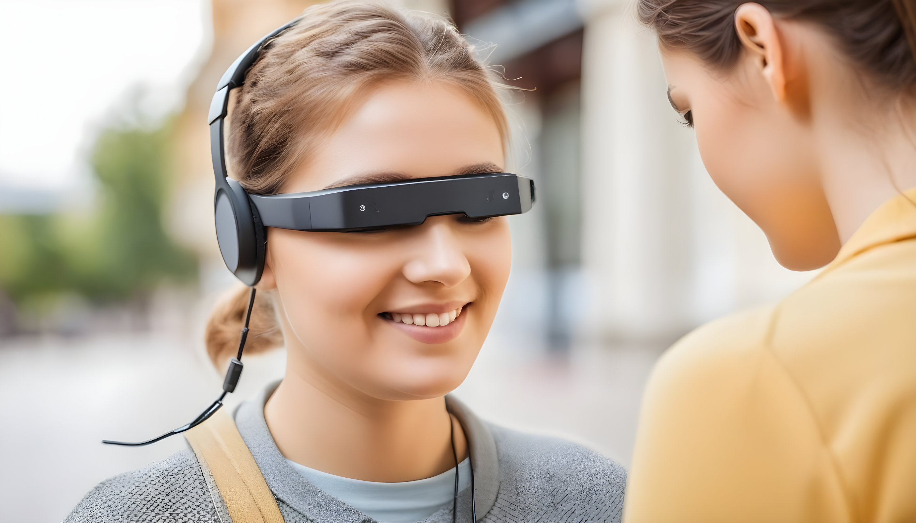
Objectives
To build device which will be able to capture image of a book and identify the text and convert and play in audio format.
The device should be able to detect the object using camera and play the object name in speaker.
DEPT OF CS&E

Slide 13
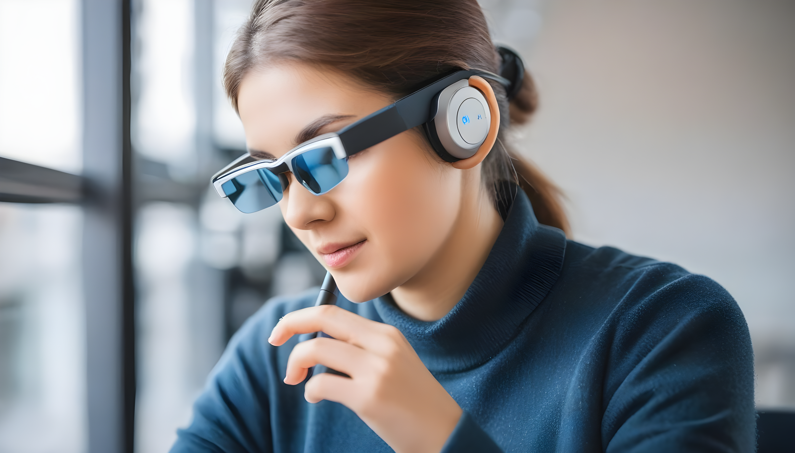
Application Of The Project
Assisting the Visually Impaired
Object Identification
Book Reading Accessibility
Inclusive Navigation
Educational Support
Hands-Free Interaction
Privacy-Preserving
Customization
User-Friendly Interface
Technological Innovation
DEPT OF CS&E

Slide 14
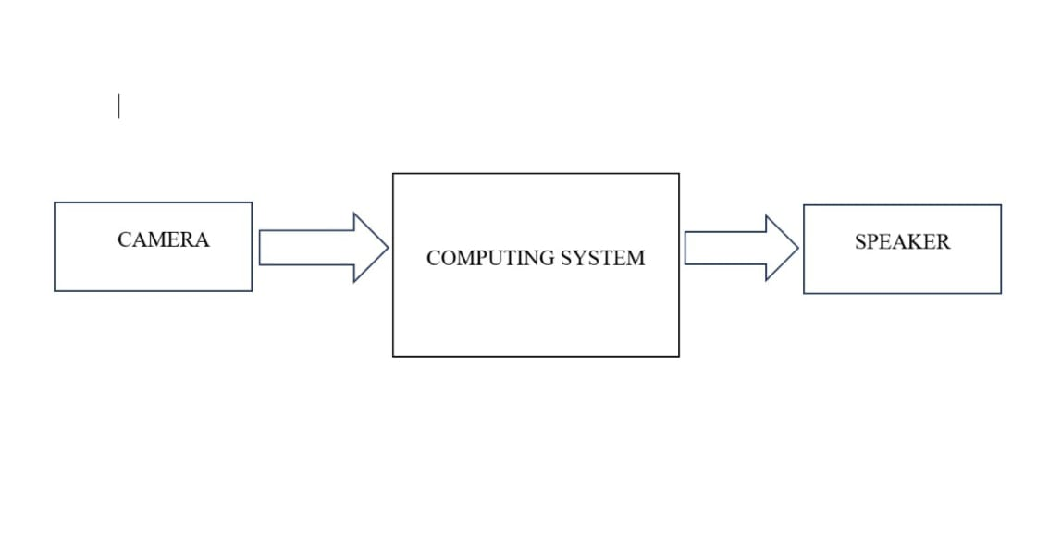
System Architecture Along With Its Modules
Block Diagram:
Blind assistant system
DEPT OF CS&E

Slide 15
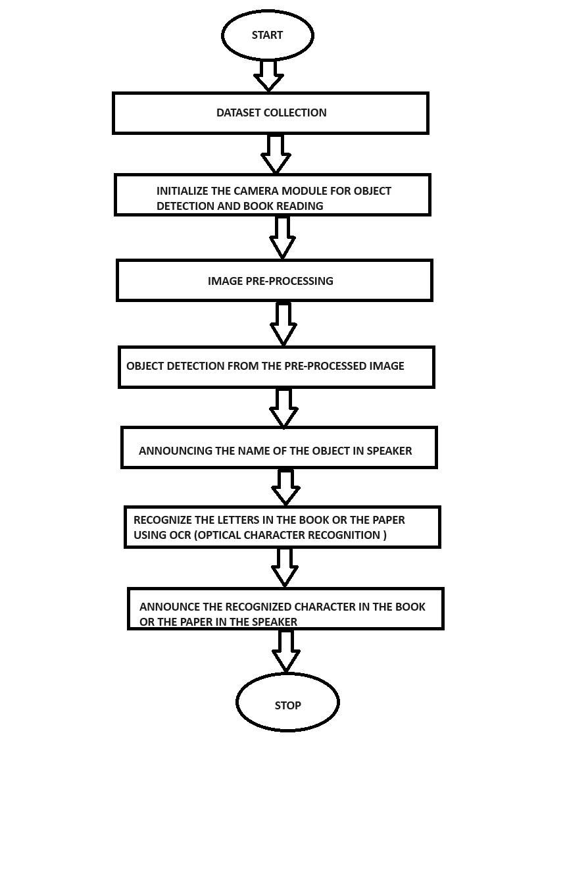
Flowchart

Slide 16
Modules
Object Detection module: Pre-trained COCO dataset.
Book reading module: OCR module.
Image processing module: To enhance image quality.

Slide 17
Software Requirements:
System Requirements
Hardware Requirements:
System : Intel i5 or above
RAM : 8 GB
Input devices : Mouse , Keyboard and Laptop camera
Hard disk : 1TB
Operating system : 32 bit or 64 bit Microsoft Windows
Programming language : Python
Tool : Open CV
DEPT OF CS&E

Slide 18
Remarkable Observations
By seamlessly integrating advanced computer vision and image processing technologies, the project empowers users to navigate their surroundings confidently through real-time object identification.
Moreover, the innovative inclusion of a book reading capability, supported by optical character recognition and text-to-speech functionalities, opens new avenues for autonomous access to written content.
DEPT OF CS&E

Slide 19
References
[1] Rajani Suryakant Kolhe, Kajal Gajanan Dhole, Pratibha Sampat Thakre, Priyanka Sohan Prasad,” Smart Stick for The Blind and Visually Impaired People”, International Journal of Scientific Research in Science, Engineering and Technology,pp.207-210,2021.
[2] Yeong-Hwa Chang, Nilima Sahoo and Hung-Wei Lin,” An Intelligent Walking Stick for the Visually Challenged People”, Proceedings of IEEE International Conference on Applied System Innovation 2018 ,IEEE ICASI 2018- Meen, Prior & Lam (Eds).
[3] K. B. Swain, R. K. Patnaik, S. Pal, R. Rajeswari, A. Mishra and C. Dash, "Arduino based automated STICK GUIDE for a visually impaired person", IEEE International Conference on Smart Technologies and Management for Computing, Communication, Controls, Energy and Materials (ICSTM), pp. 407- 410, 2017.
DEPT OF CS&E

Slide 20
[4] Nadia Nowshin, Sakib Shadman, Saha Joy, Sarker Aninda, Islam Md Minhajul, “An Intelligent Walking Stick for the Visually Impaired People", International Journal of Online and Biomedical Engineering (iJOE), vol. 13, No. 11, 2017.
[5] Radhika R, Payal G Pai, Rakshitha S, Rampur Srinath, "Implementation of Smart Stick for Obstacle Detection and Navigation", International Journal of Latest Research in Engineering and Technology (IJLRET), vol. 02, pp. 45-50, 2016.Manikanta K, T. Siva Sankara Phani and A. Pravin, "Implementation and Design of Smart Blind Stick for Obstacle Detection and Navigation System", 2018
DEPT OF CS&E

Slide 21
THANK YOU
DEPT OF CS&E

